Slide 1
The FAQ System Overview & Functions
22nd September 2015
Notes:
Note here

Slide 2
FAQ System Overview
-The FAQ (Frequently Asked Questions), are listed questions and answers, all supposed to be commonly asked in some context. And user can find the information, tips and help topics useful.
-The FAQ system . It’s the content manager system, manage the questions & answers
User
Admin
Search FAQ
List FAQs
Add question
Answer
List of Categories
Add/Edit Category
Export FAQs
Search FAQ
Add/Edit FAQ

Slide 3
List Functions
No | Role | Functions | Description
1 | User | Search FAQ | Search FAQ with an entry keyword. It's also possible to search only in one selected category
2 | User | Add question | On the Add question page it's possible for all users to add a new question without an answer.
3 | Admin | Categories | Show the all categories list
4 | Admin | Add Category | Create different categories and nested sub-categories for your FAQ
5 | Admin | FAQ | Display all FAQs list
6 | Admin | Add new FAQ | Create new FAQs for each category.
7 | Admin | Edit existing FAQs | We can edit all available FAQs
8 | Admin | Search FAQs | Search all available FAQs
9 | Admin | Attachments | In the attachment administration we can see an overview of all attachments with their filename, file size, MIME type.
10 | Admin | Open questions | Display list of all unanswered question
11 | Admin | Export FAQs | We can export FAQ of all categories or just some selected category

Slide 4
Main page (User)
The header has the main links for add questions. On the left side we only see the All categories and main categories links
FAQ site name
Add question
FAQ Home
All categories
Category 1 >
Sub Category 1.1
Sub Category 1.2
Category 2 >
Sub Category 2.1
Sub Category 2.2
Search FAQ area…
Most popular FAQs
Question 1
Question 2
Question 3
Categories with FAQs / Search Result…
Company Information

Slide 5
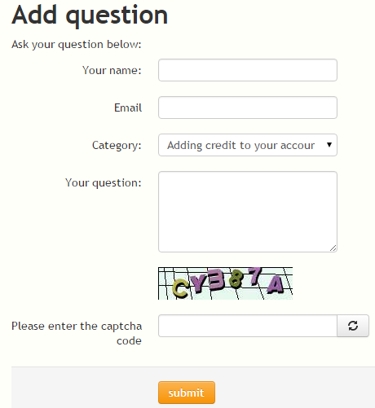
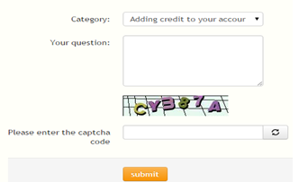
Add question
The users have to add a question, select a category, and they have to insert their name. If the spam protection is enabled they have to enter the correct captcha code, too.
FAQ site name
Add question
FAQ Home
All categories
Category 1
Sub Category 1.1
Sub Category 1.2
Category 2
Sub Category 2.1
Sub Category 2.2
Most popular FAQs
Question 1
Question 2
Question 3
Company Information

Slide 6
Content Management (for Admin)
We can administrate our categories, FAQ records, attachments
FAQ site name
Content Administration
-Categories
└Add Category
-FAQ
├Add new FAQ
└Edit existing FAQs
└Search for FAQs
-Open questions
-FAQ Attachments
-Export
FAQ’s Categories: List all categories
Company Information

Slide 7
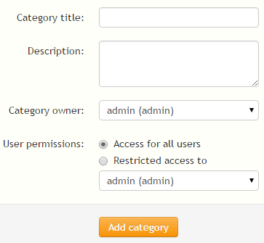
Add new category (Main Category)
Create different categories and nested sub-categories for your FAQ
FAQ site name
Content Administration
-Categories
└Add Category
-FAQ
├Add new FAQ
└Edit existing FAQs
└Search for FAQs
└Attachments
-Open questions
-Export
Add new category (top-level category)
Company Information

Slide 8
List of FAQs
Display all FAQs list
FAQ site name
Content Administration
-Categories
└Add Category
-FAQ
├Add new FAQ
└Edit existing FAQs
└Search for FAQs
└Attachments
-Open questions
-Export
FAQ Administration : show list all FAQs
Company Information

Slide 9
Add new FAQ
Create new FAQs for each category.
FAQ site name
Content Administration
-Categories
└Add Category
-FAQ
├Add new FAQ
└Edit existing FAQs
└Search for FAQs
└Attachments
-Open questions
-Export
Add new FAQ : make new FAQ
Company Information

Slide 10
Edit existing FAQs
We can edit all available FAQs
FAQ site name
Content Administration
-Categories
└Add Category
-FAQ
├Add new FAQ
└Edit existing FAQs
└Search for FAQs
└Attachments
-Open questions
-Export
List all existing FAQs for edit
Company Information

Slide 11
Search for FAQs
Search all available FAQs
FAQ site name
Content Administration
-Categories
└Add Category
-FAQ
├Add new FAQ
└Edit existing FAQs
└Search for FAQs
└Attachments
-Open questions
-Export
Search for FAQs
Company Information

Slide 12
Attachments
In the attachment administration we can see an overview of all attachments with their filename, file size, MIME type. You can delete them, too
FAQ site name
Content Administration
-Categories
└Add Category
-FAQ
├Add new FAQ
└Edit existing FAQs
└Search for FAQs
└Attachments
-Open questions
-Export
Attachment administration
Company Information

Slide 13
Open questions
Display list of all unanswered question
FAQ site name
Content Administration
-Categories
└Add Category
-FAQ
├Add new FAQ
└Edit existing FAQs
└Search for FAQs
└Attachments
-Open questions
-Export
List Open Question
Company Information

Slide 14
Export FAQs
We can export your contents of your whole FAQ or just some selected categories into four formats:
a XML file
a plain XHTML file
a PDF file with a table of contents
FAQ site name
Content Administration
-Categories
└Add Category
-FAQ
├Add new FAQ
└Edit existing FAQs
└Search for FAQs
└Attachments
-Open questions
-Export
Export your FAQ
Limit the FAQ data to be exported (optional)
Format of the export
Company Information

